Slide 1

Feature Based Opinion Mining
Mahadevan N
Apurva Mhatre
Ajun Nair

Slide 2
ABOUT THE PROJECT
The project aims to make use of the highly unstructured text reviews about any product, extract the potential features about the product, assign scores to them and then classify the reviews as either positive or negative.
The features of the product play a crucial role in the decision making process of the potential customer. It is these features that distinguish one product from other similar products from different brands. Most of the companies focus on a specific feature as their selling point.

Slide 3
Literature Survey
SN | Techniques | Author & Year of Publication | Advantages and Disadvantages
1. | Semantic orientation of conjoined adjectives using log-linear regression | V. Hatzivassiloglou, K.R. McKeown, Predicting the semantic orientation of adjectives, 2010 | Advantages: The mentioned work properly classifies the opinion words and its respective semantic orientation. Disadvantages: It only lays stress on opinion words and do not consider the features.
2. | An unsupervised method to extract syntactic structures that specify the orientation of clauses for domain oriented semantic analysis | H. Kanayama, T. Nasukawa, Fully automatic lexicon expansion for domain-oriented sentiment analysis, 2006 | Advantages: The given work successfully extracts context-dependent opinion words from large corpora. Disadvantages: It does not incorporate the proposed methodology in a broader opinion mining framework.

Slide 4
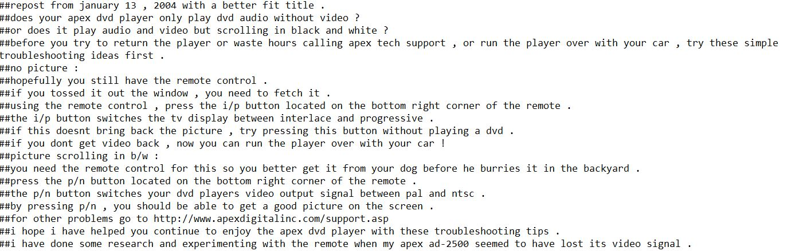
Dataset
Actual reviews of customers on different products sold on Amazon
Example:

Slide 5
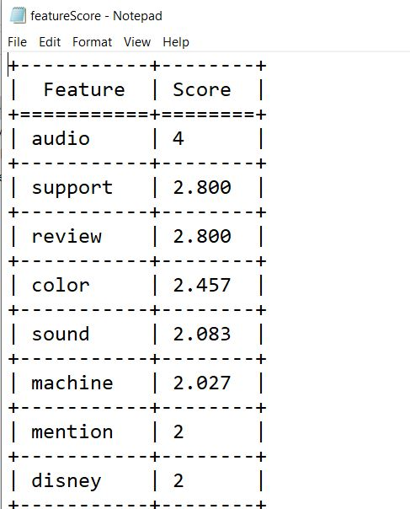
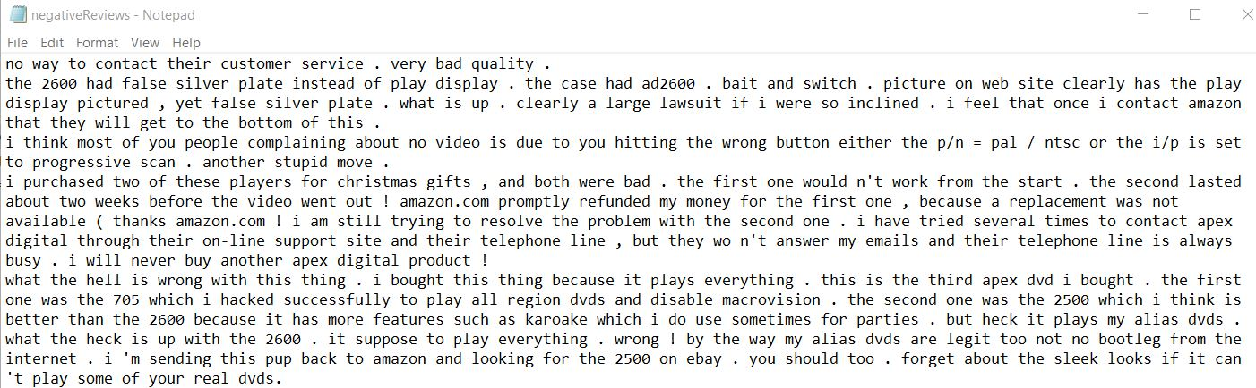
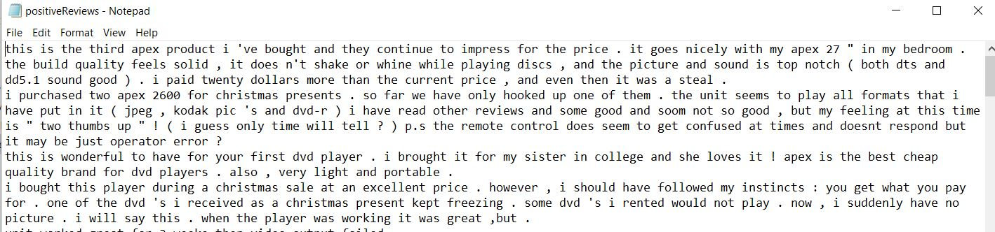
Output
Feature Score
Negative Reviews
Positive Reviews

Slide 6
Python Libraries used
Text Blob
NLTK
Scikit

Slide 7
Algorithm
Identify adjectives in the reviews describing a noun (potential features)
Assign a score to each noun based on adjectives in the selected review
Analyse the adjectives strength and assign them a score
Look out for inversion words
For each sentence in the review, adjectives are identified and features closest to it.
The score of feature is summation of scores of adjectives associated with it.
The scores of features are further summed up to calculate score of review
Classify each review as positive negative or neutral

Slide 8
Thank You

